Slide 1
A Minor Project on Face Detection & Recognition
Deepa Bhandari 14/336
Rohan Baidya 14/335
Deepak Pd. Shah 14/328
Punita Kushwaha 14/316

Slide 2
A BRIEF INTRO …

Slide 3

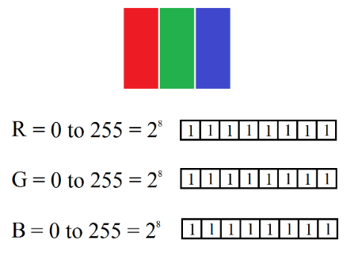
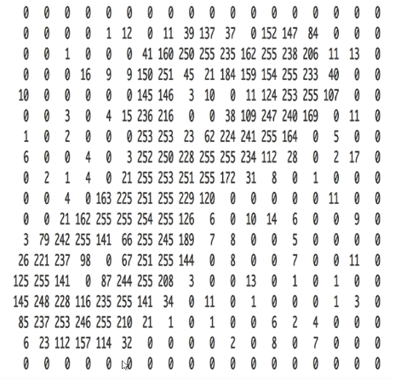
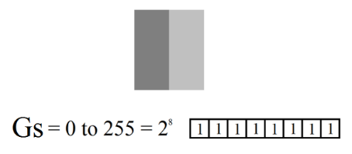
A Digital Image is an array of unit dots called Pixels on 2D space.
A Video is a stream displaying continuous and consecutive images.
Resolution: Total number of pixels in the sample image space.
Color Depth: Total primary colors and bits per each color in an image.

Slide 4
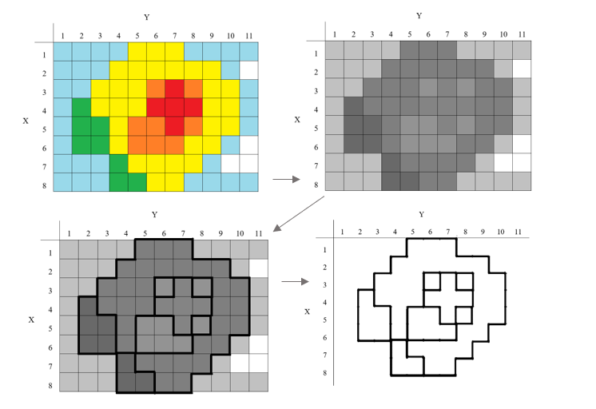

Slide 5
LITERATURE REVIEW

Slide 6
History begins …
in 1960s, Woody Bledsoe, Helen Wolf, and Charles Bison made the first face recognition using computer.
In 2001, Paul Viola & Michael Jones developed an efficient algorithm for Face Detection called Robust Object Detection Framework.
Object recognition is a process for identifying specific object in digital image or video relying on matching, learning, pattern recognition etc.

Slide 7
What is FDR?
Face Detection and Recognition (FDR) is the use of computer vision similar to how human identify people and their identity.
It consists of three basic steps:
Face Detection : that identifies face like pattern in a space
Face Feature Extraction : that extracts the facial features (landmarks)
Face Recognition : that gives the probability of the face match

Slide 8
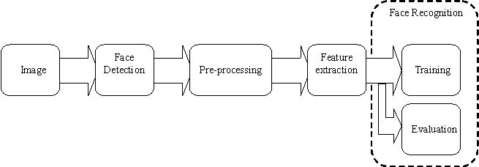

Slide 9
Objective
To make a real time application to stream video and detect Face:
Using OpenCV (haarcascade.xml) and Python Script
To add the sample image or train set and supply data: to the data set content (trainer/trainer.yml) file
To recognize face and load data from database of faceprint:
using local database (FaceDB.db) under SQLite3

Slide 10
FACE DETECTION

Slide 11
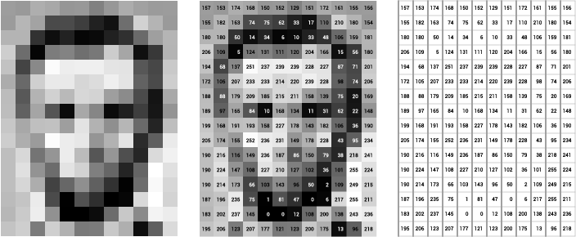
Overview

Slide 12
Image Classifier
Analyze / categorize classes, or "themes“ of unknown object pixels based on no. of instances of each classes known as training set.
Multispectral data perform classification, and the pattern in data is used for each pixel’s numerical value as basis for categorization.
The objective is to identify and portray, as a unique gray level (or color) of the features occurring in an image.

Slide 13
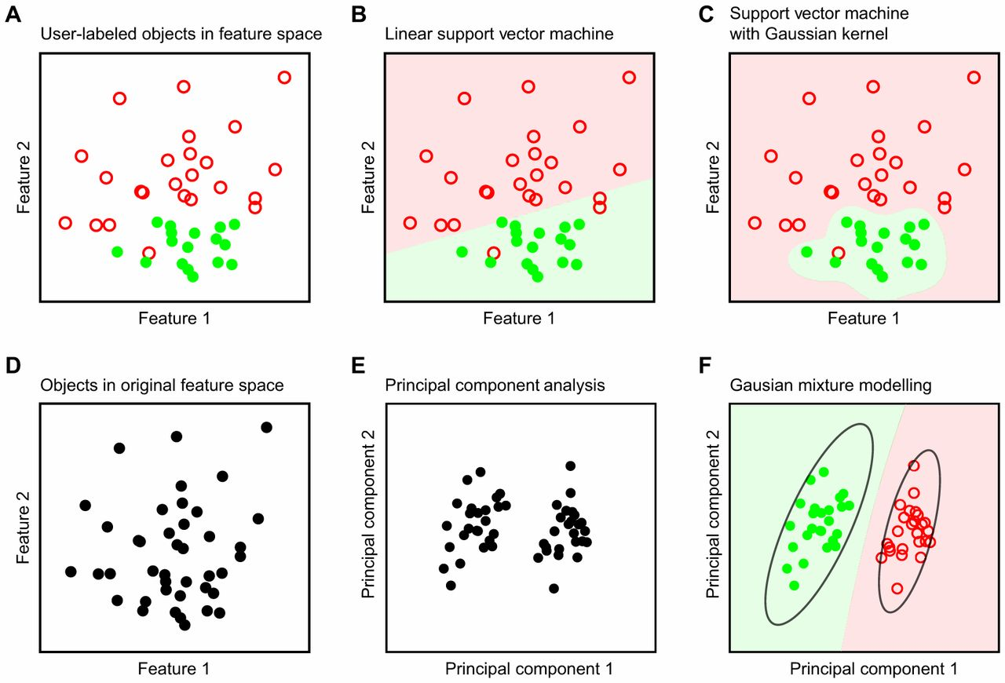

Slide 14
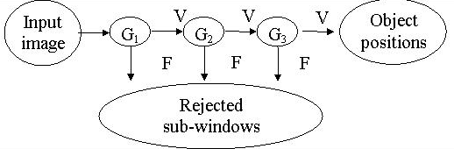
Cascade Classifier
Cascade is a stage by stage operation by taking critical visual features
Combines Weak Classifier to Strong Classifiers (Adaptive Boosting)

Slide 15
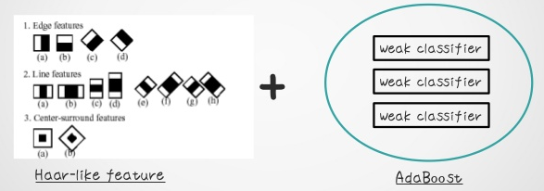
Haar - Cascade Classifier

Slide 16
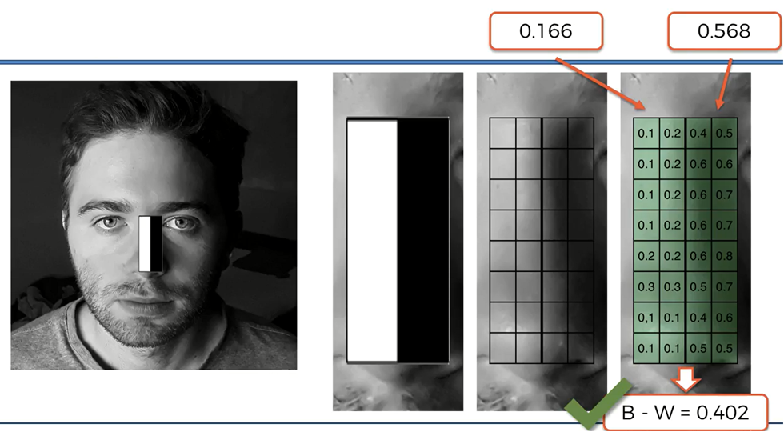
Haar – Like Feature

Slide 17
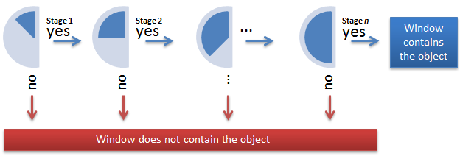
Ada – Boosting

Slide 18
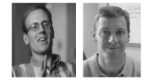
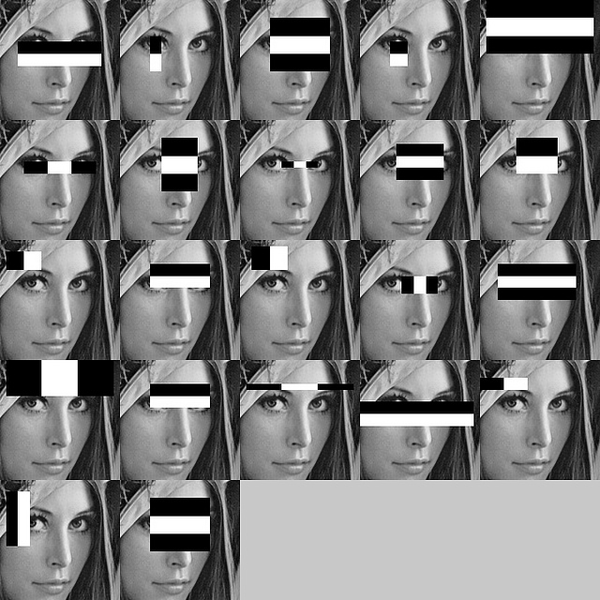
Viola – Jones Algorithm
ROBUTS
QUICK
ACCURATE

Slide 19


Slide 20
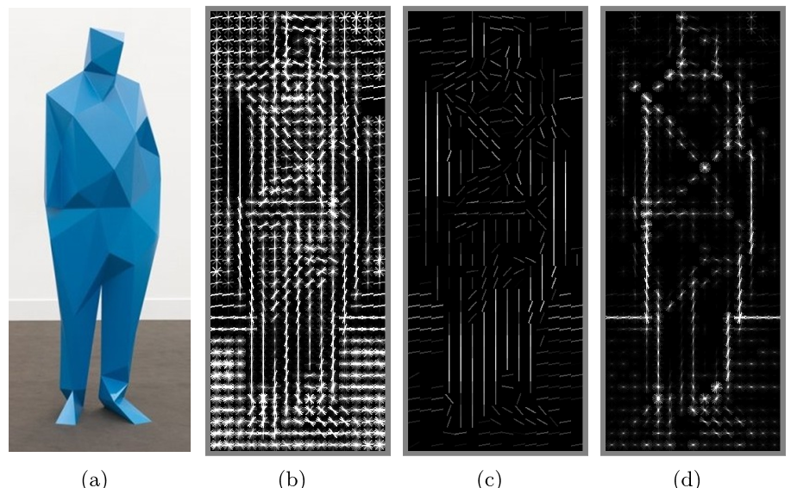
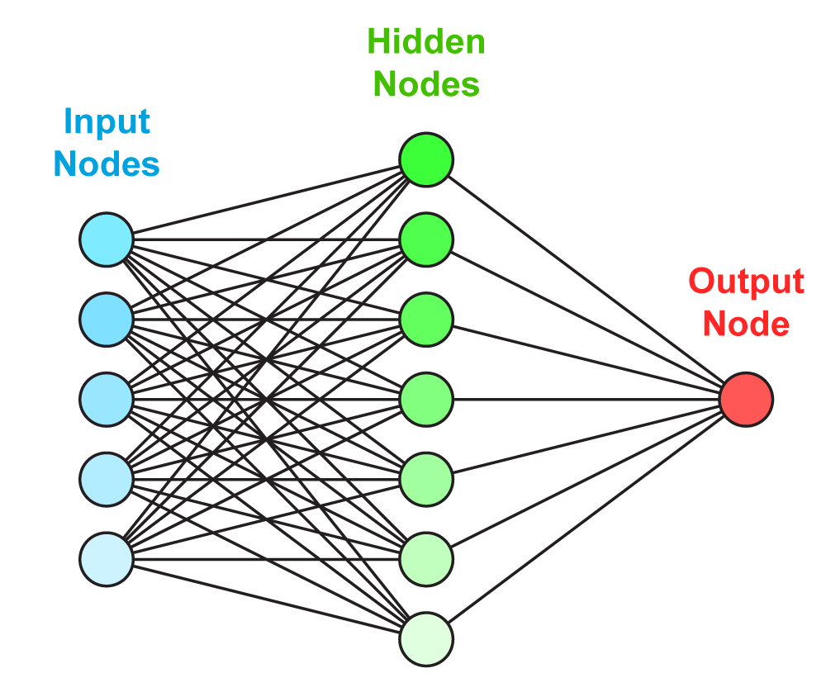
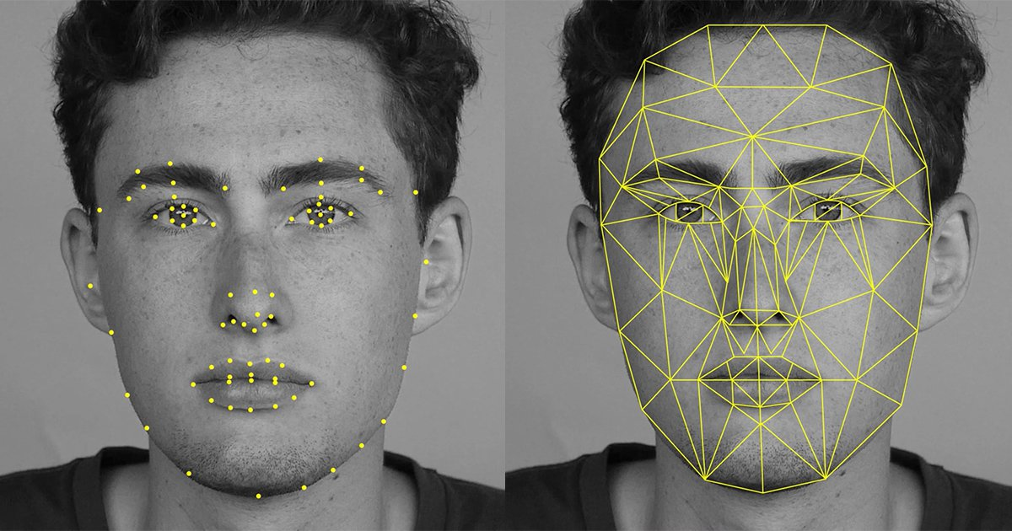
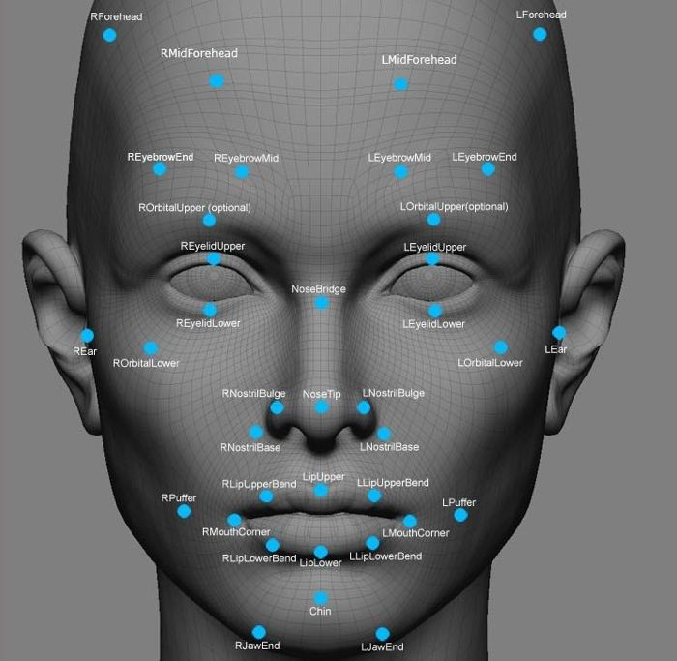


Other Methods …

Slide 21
FACE FEATURE EXTRACTION AND FACE RECOGNITION

Slide 22
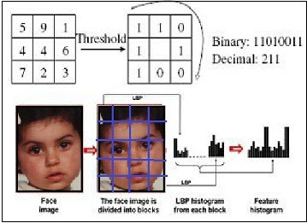
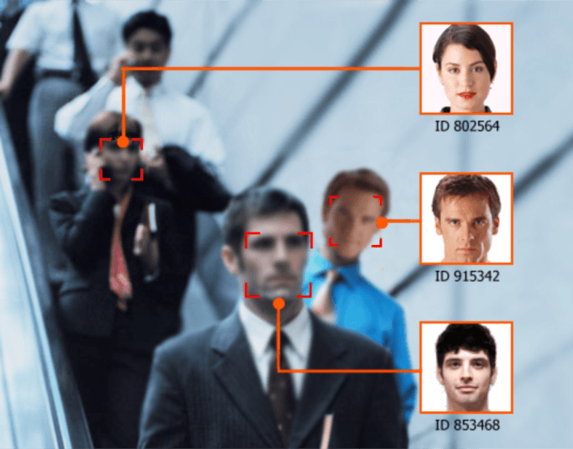
LBPH Method

Slide 23
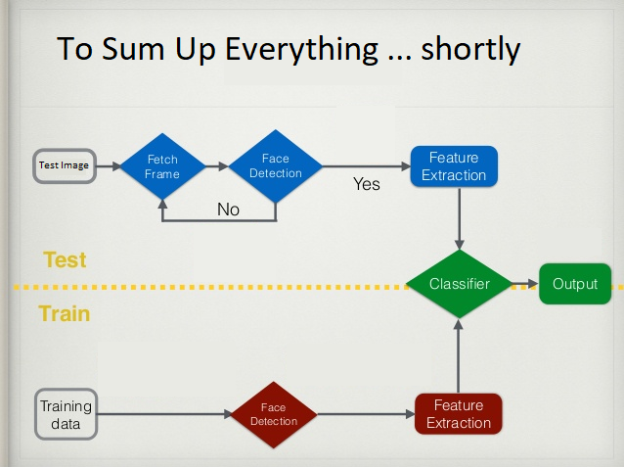

Slide 24




Platform
Groundwork
Python 2.7 (IDLE)
Numpy
Imaging Library / Tools
Open CV 3.2
PIL (Python Imaging Library)
Front End
Tkinter
Database
SQLite3

Slide 25
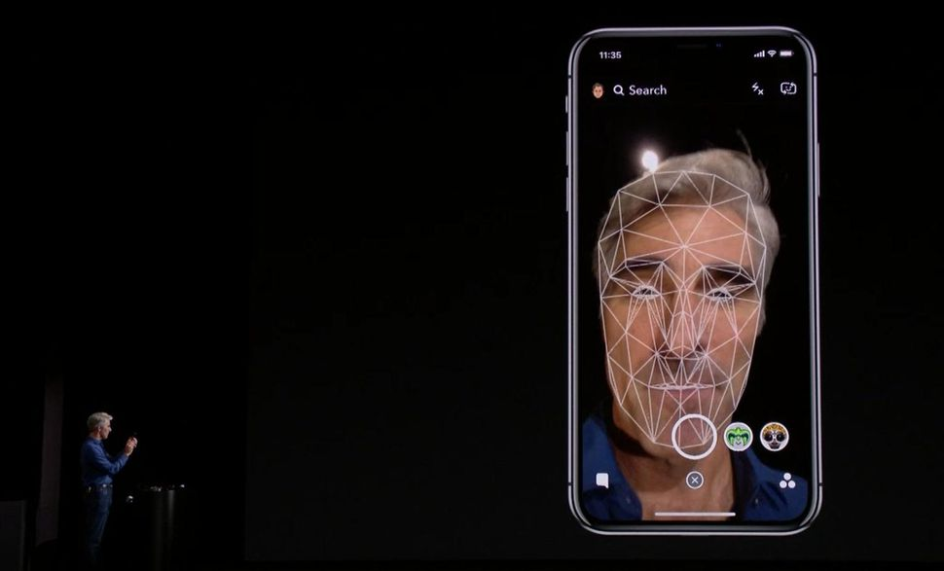

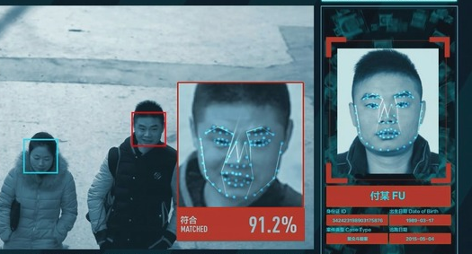
Application Areas
Enhance Security Measures
Permit Authorize Access
Intelligence Agency
Forensic and Medical Diagnosis

Slide 26
Reference
https://www.docs.opencv.org/2.4/modules/contrib/doc/facerec/facerec_tutorial.html [site visited on: 4th October, 2017]
https://docs.opencv.org/trunk/d7/d8b/tutorial_py_face_detection.html [site visited on: 20th October, 2017]
https://thecodacus.com/opencv-python-face-detection/#.WpGxtExuJuk [site visited on: 19th January, 2017]

